Slide 1
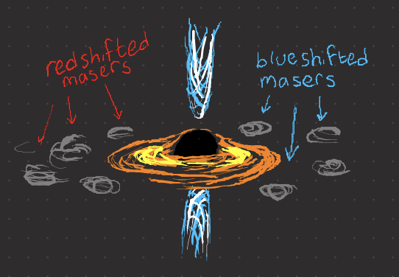
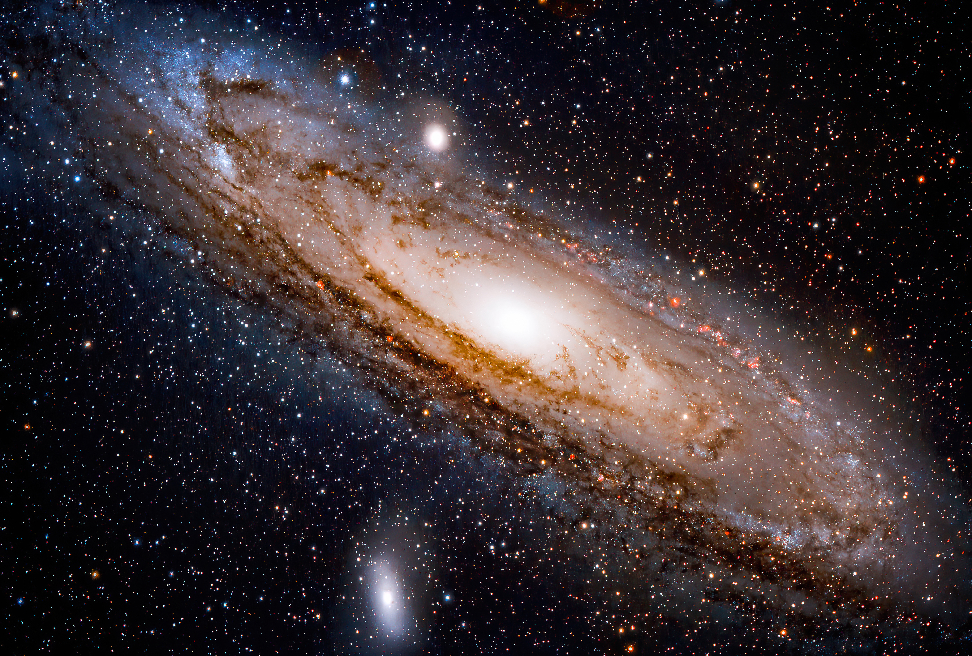
Probing the AGN Nature of Maser Galaxy Hosts
Gaudeor Rudmin
Dr. Anca Constantin
James Madison University
Summer 2023

Slide 2
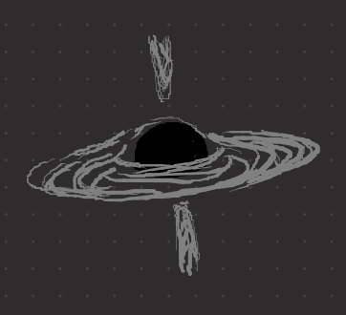
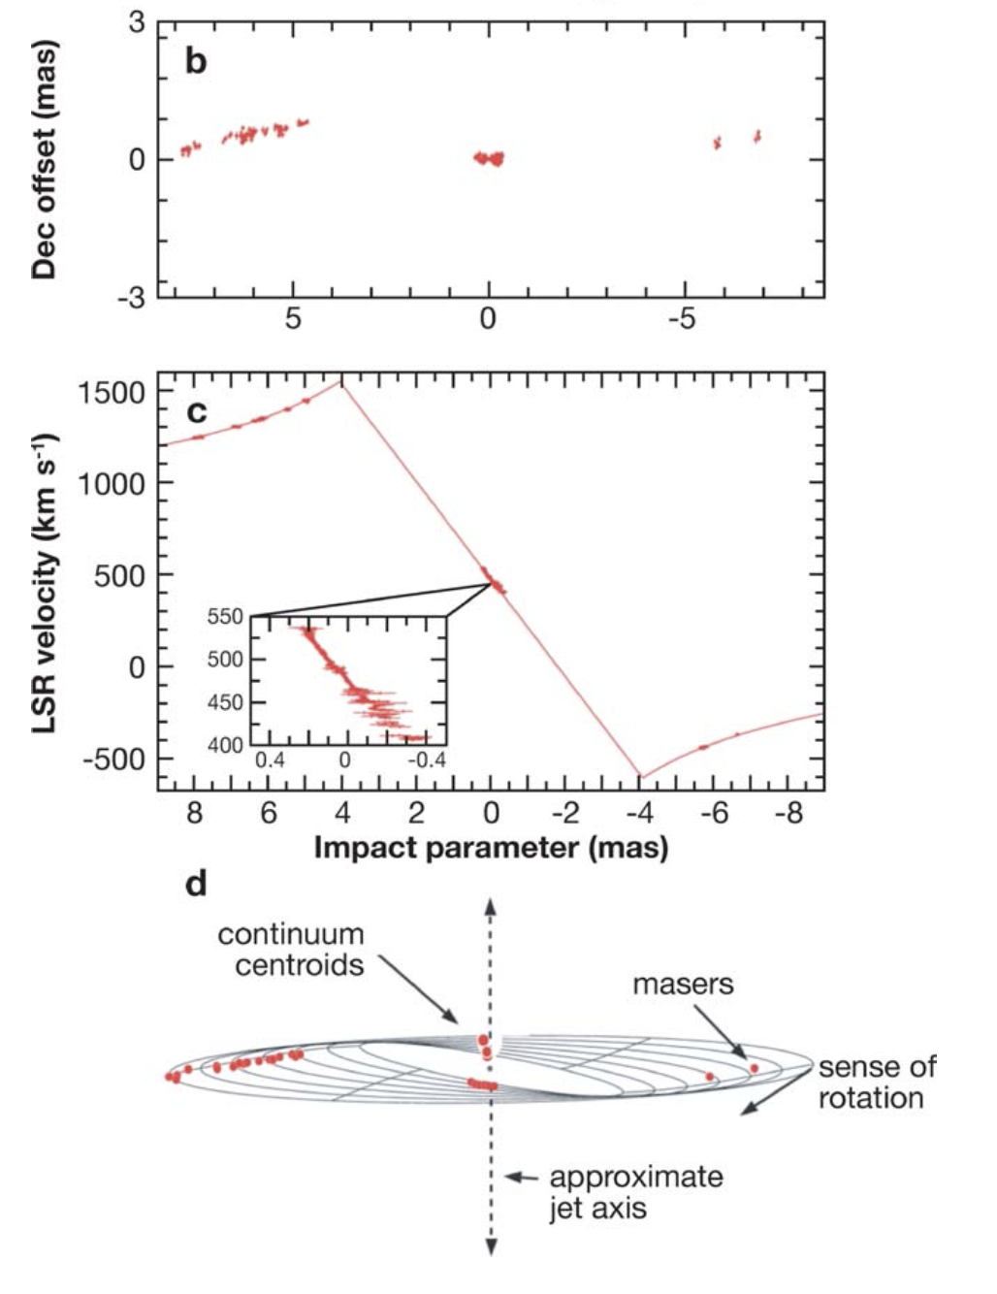

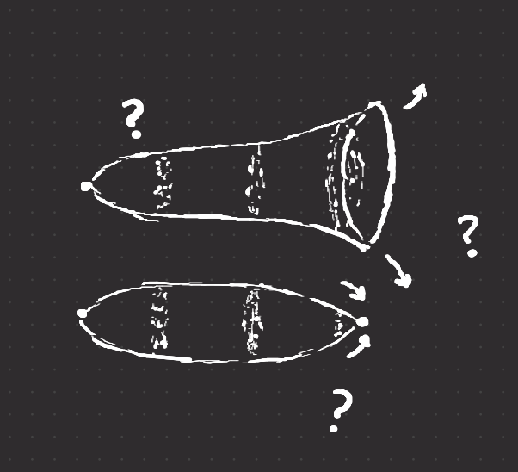
Why do we care about Maser Emission?
How massive are supermassive black holes?
How far away are other galaxies?
How do we refine cosmological models?
What is the fate of the universe?
Geometric Measurement via
Newtonian Physics
Masers are extremely rare:
< 3% of surveyed galaxies are masers
< 0.2% are in a Disk configuration

Slide 3
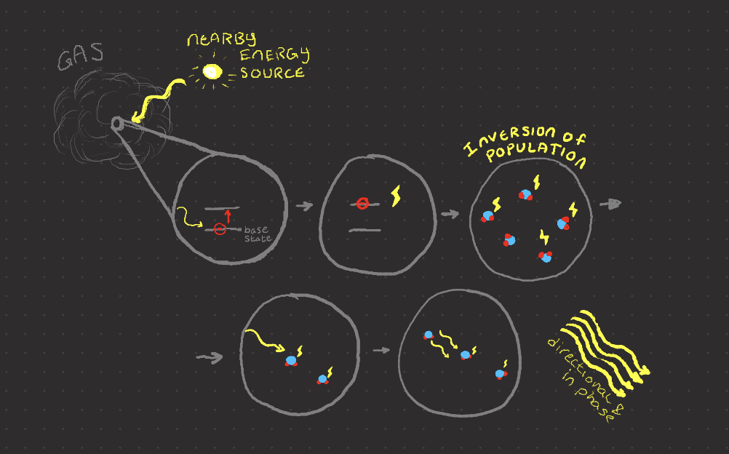
What are Masers?
Laser in
Microwave
Emitted by hot,
high density (for space)
gas with a nearby energy source
Type based on energy source

Slide 4
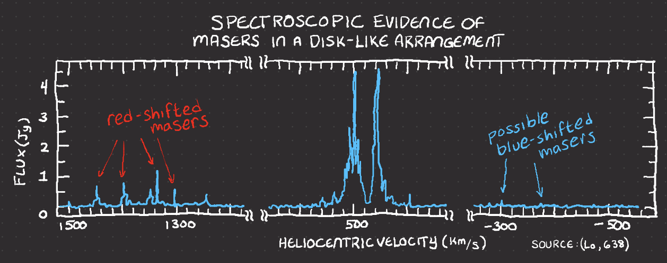
Types of Masers
Masers near Star-forming areas
MegaMasers (1 M x more luminous)
From Galaxy Centers
Maser Disks (rare, only 34 known)

Slide 5
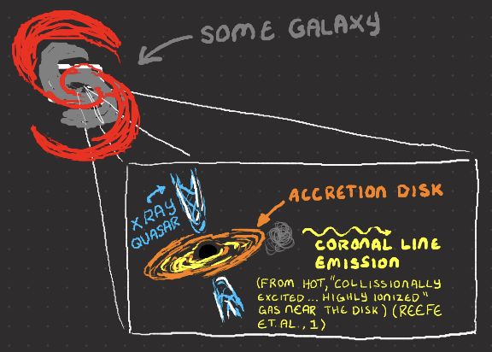
AGN connection to Maser Emission
Active Galactic Nuclei (AGN)
Hungry Black Hole at the center of a Galaxy
Accretion disk of gas and dust
We know more about AGN than
about masers, so finding a
connection could help us understand
Megamasers’ properties.

Slide 6
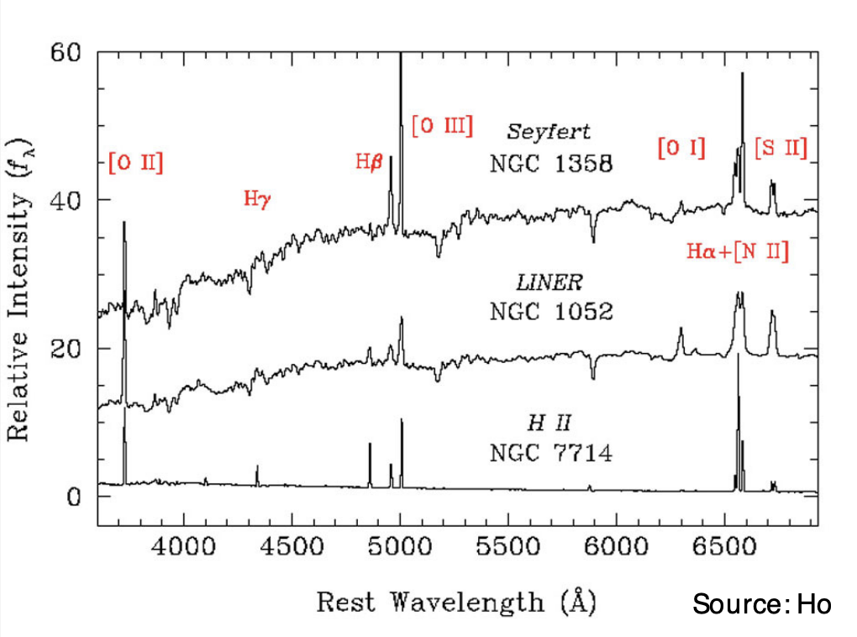
Identifying AGN
X-Ray
Optical Lines
Mid-infrared & Variability
Covered by Emily McPike
Coronal Lines
We Used Optical and Coronal lines

Slide 7
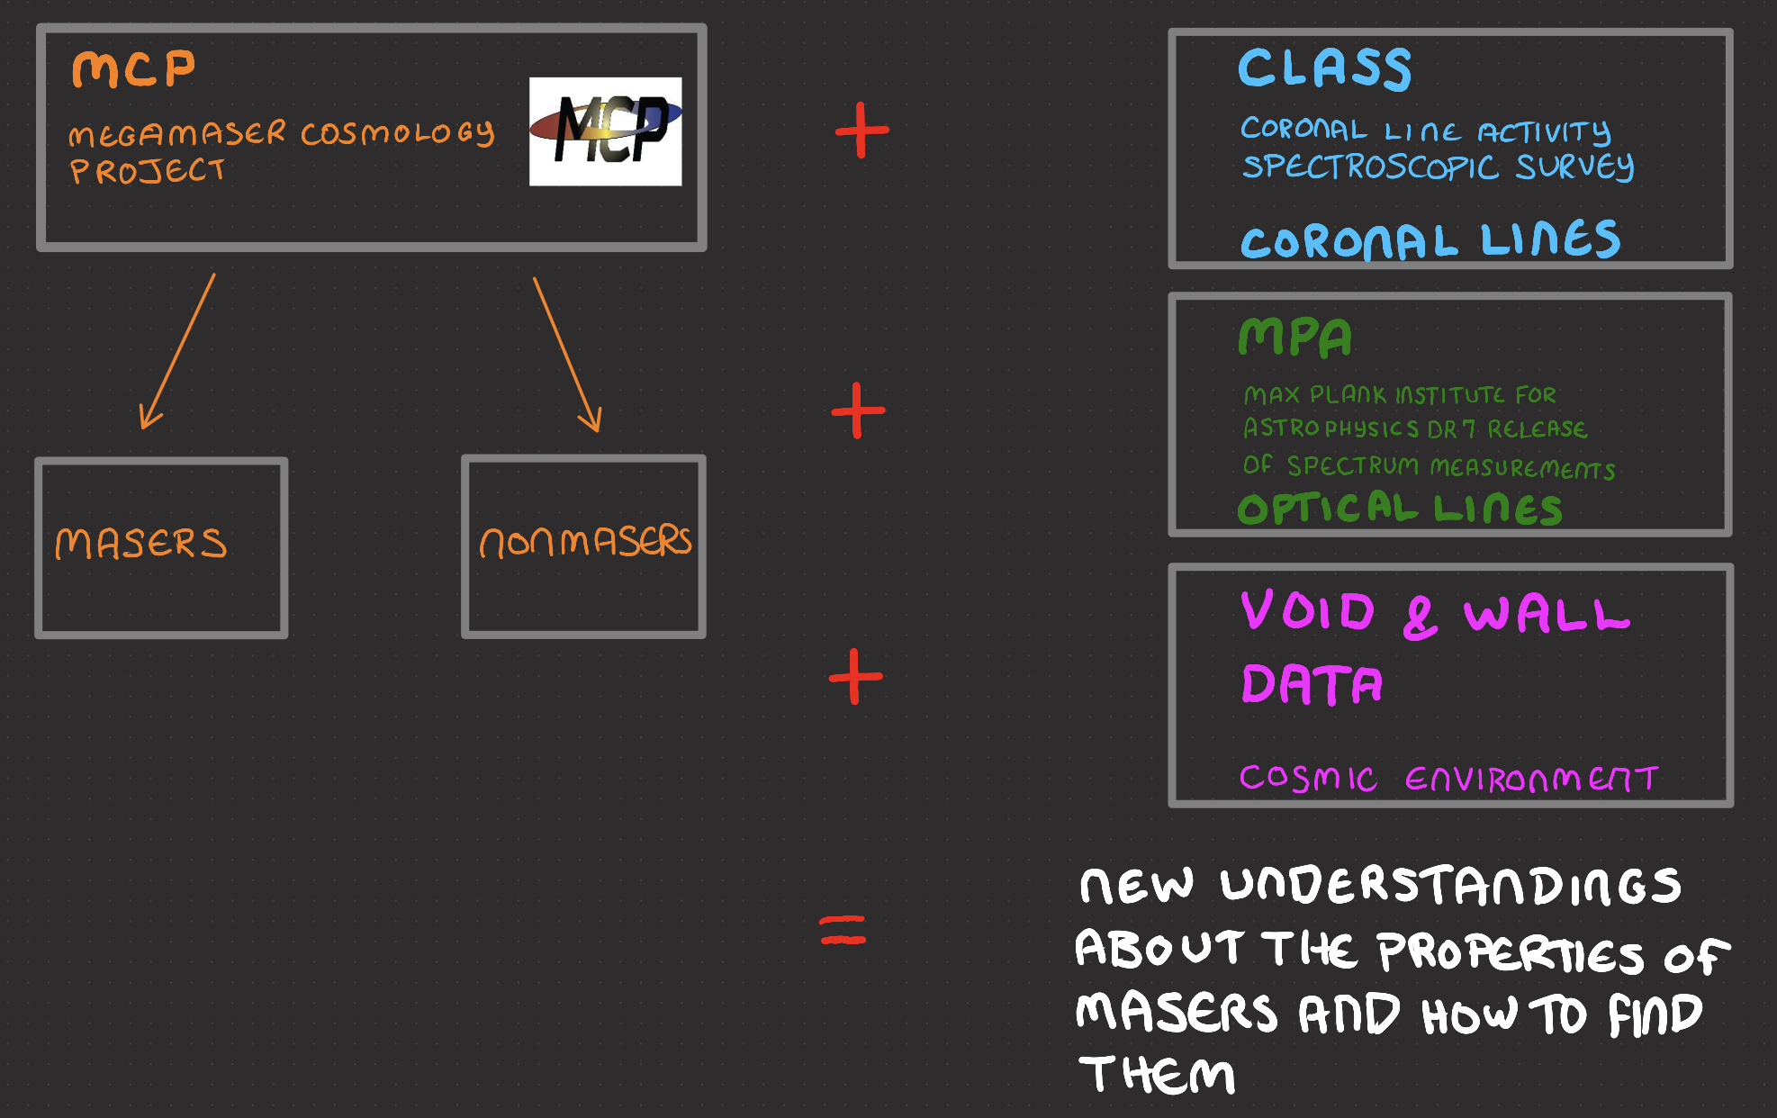
The Data

Slide 8
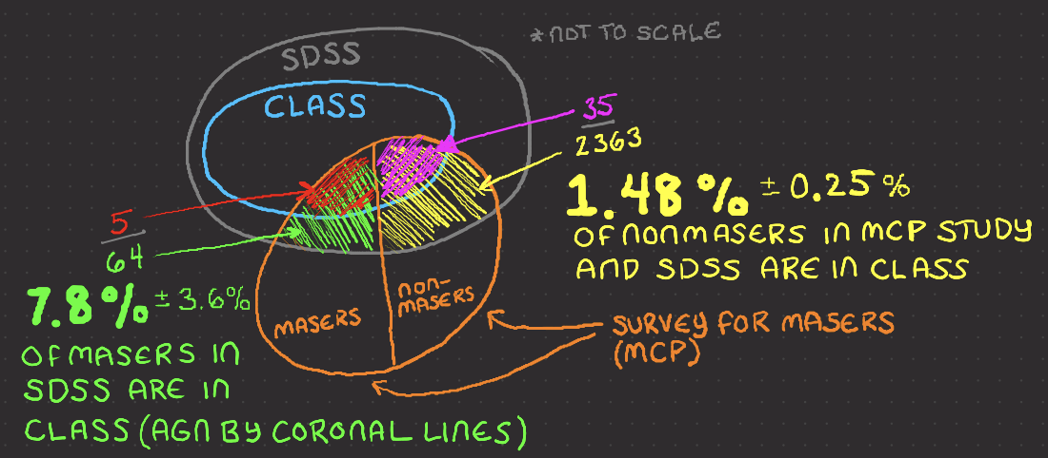
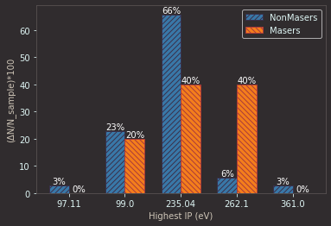
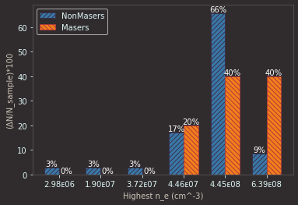
Masers VS Coronal Line AGN
A higher percentage of
Masers have coronal
Lines (so are AGN) than
Nonmasers.
Physical Properties
Associated with
Coronal Lines

Slide 9
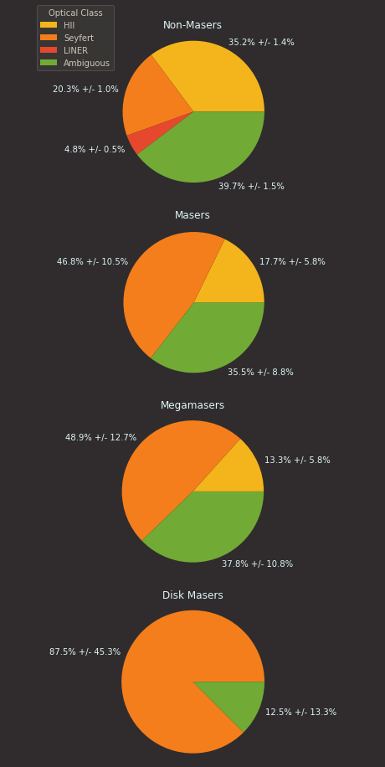
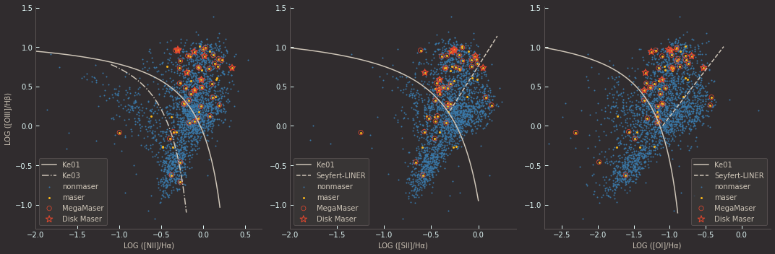
Masers VS Optical Line AGN
Masers are concentrated in the Seyfert AGN area.
Disk Masers are almost exclusively Seyfert AGNs

Slide 10
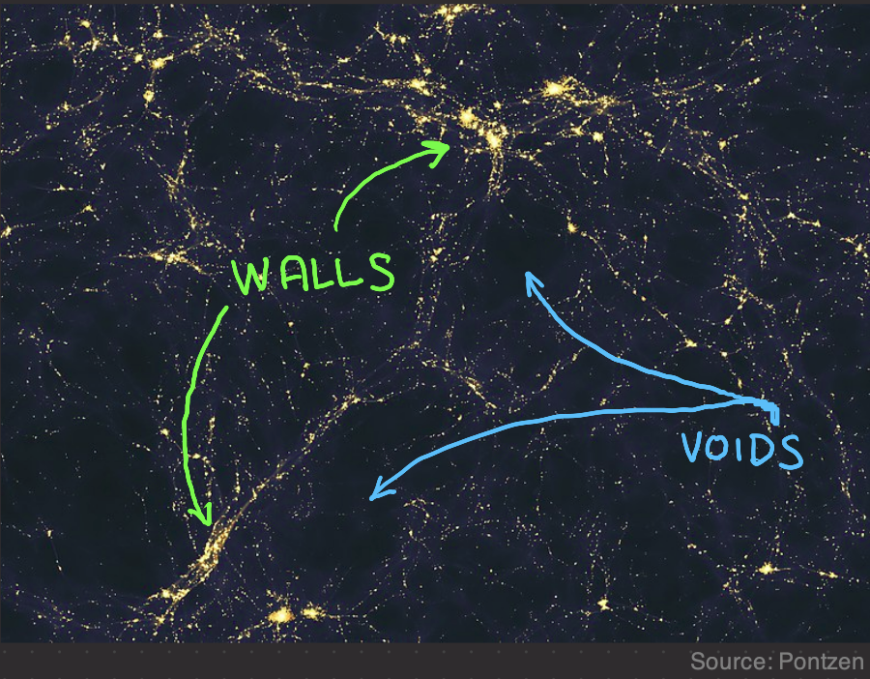
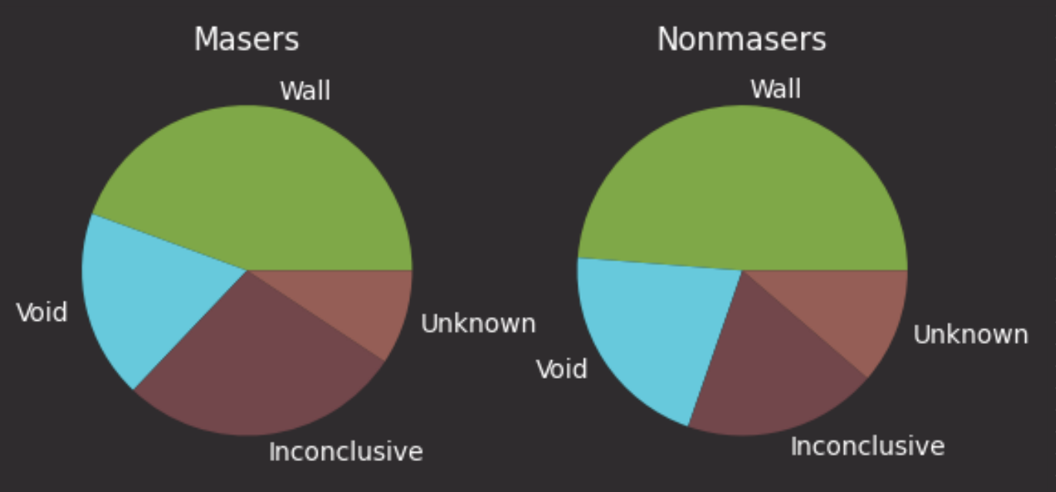
Masers VS Cosmic Environment
Location | Masers | Nonmasers
Wall | 44.4% +/- 10.9% | 48.7% +/- 1.8%
Void | 18.5% +/- 6.4% | 20.9% +/- 1.1%
Inconclusive | 27.8% +/- 8.1% | 19.0% +/- 1.0%
Unknown | 9.3% +/- 4.3% | 11.3% +/- 0.8%

Slide 11
Conclusions
There were statistically significant differences between Masers and Nonmasers using:
Coronal Line AGN Detection
Optical Line AGN Detection
They may be useful tools in narrowing the search for usable Maser Disks
Galaxy’s location in the cosmic environment does not seem to be a useful tool.

Slide 12
References
Ho, L. C. (2008). Nuclear Activity in Nearby Galaxies. Annual Review of Astronomy and Astrophysics, 46(1), 475–539. https://doi.org/10.1146/annurev.astro.45.051806.110546
Keel, B. (2002, November). Optical Spectra of Various Kinds of Active Galactic Nuclei. Active Galaxies and Quasars - Spectrum Comparison. https://pages.astronomy.ua.edu/keel/agn/spectra.html
Lo, K. Y. (2005). Mega-masers and Galaxies. Annual Review of Astronomy and Astrophysics, 43(1), 625–676. https://doi.org/10.1146/annurev.astro.41.011802.094927
Pontzen, A., &amp; Governato, F. (2014). Large-scale Structure of Light Distribution in the Universe. Wikimedia Commons. Retrieved July 25, 2023, from https://commons.wikimedia.org/wiki/File:Large- scale_structure_of_light_distribution_in_the_universe.jpg.
Reefe, M., Satyapal, S., Sexton, R. O., Doan, S. M., Secrest, N. J., &amp; Cann, J. M. (2022).
Class: Coronal line activity spectroscopic survey. The Astrophysical Journal, 936(2), 140.
https://doi.org/10.3847/1538-4357/ac8981

Slide 13
Thanks To:
Dr.

